Slide 1


SPECFEM++ Workshop
CIG Meeting, Breckenridge, 2025
Rohit Kakodkar, Congyue Cui & Lucas Sawade
Research Computing/Geosciences Department

Slide 2
Agenda for today
Introduction to Specfem++
Hands-on Installation & Tutorials
Deep dive into Kokkos
SPECFEM++ with respect to the equations

Slide 3
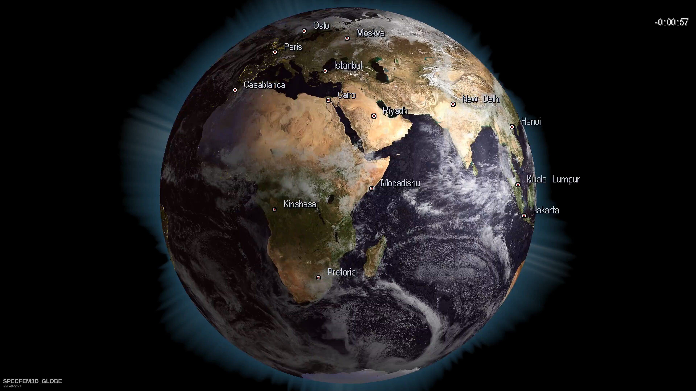
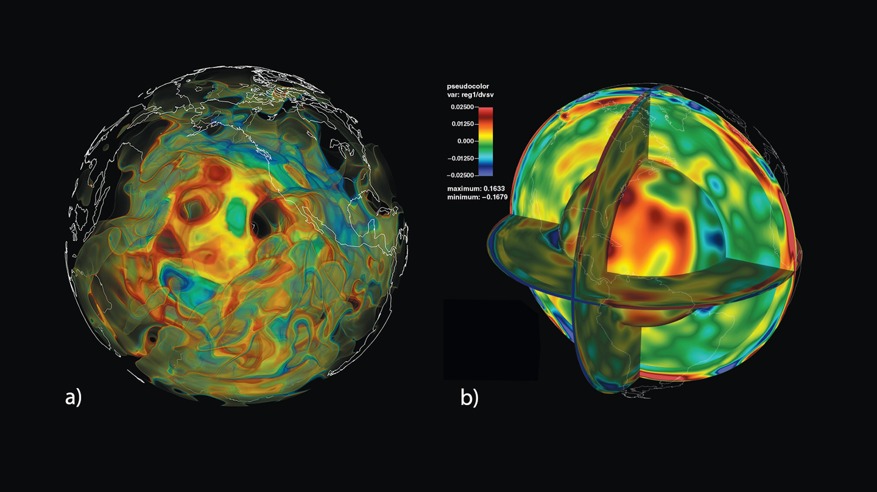
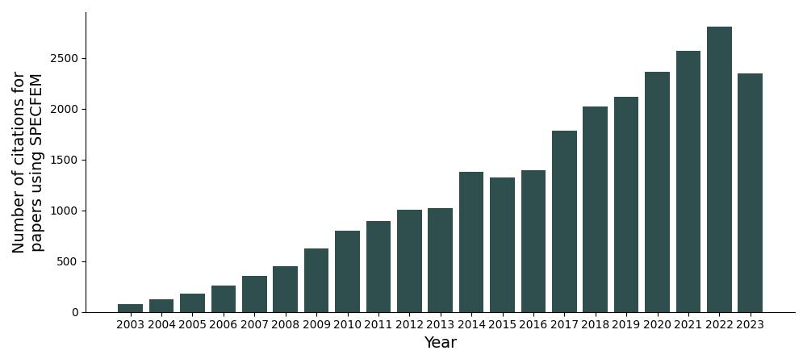
SPECFEM
SPECFEM is a suite of spectral element codes used to simulate wave propagation through heterogeneous media
Mostly used for seismic simulations*
Adjoint simulations to do inverse imaging
Diverse user-base
> 300 stars on 3 repositories
Different machines
Summit
Frontier
CINECA

Slide 4
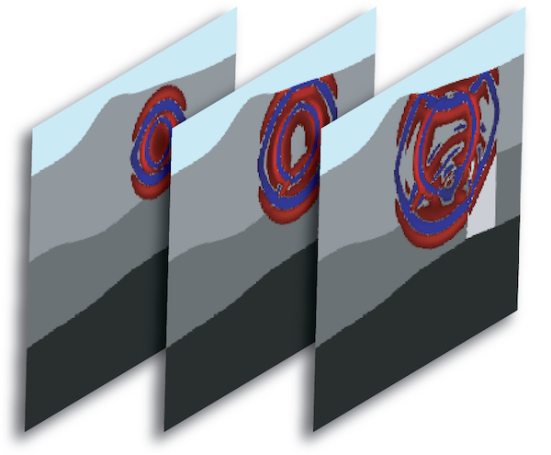
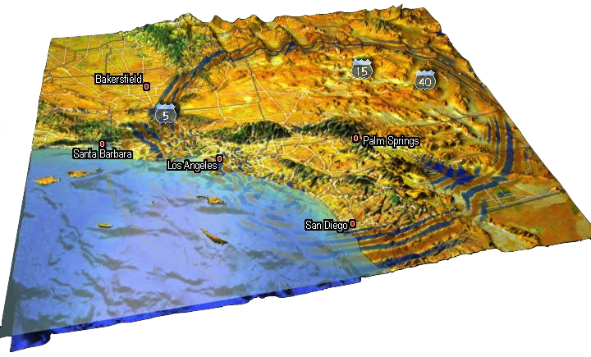
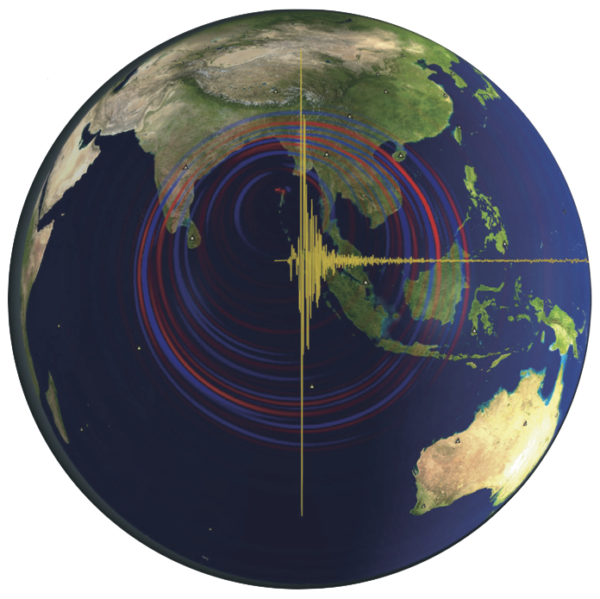
SPECFEM
SPECFEMX
SEMGPETSC
SPECFEM2D
SPECFEM3D
SPECFEM3D Globe
Large package
Fortran package (developed since 1999)
> ~150k LOC
Supports NVIDIA (CUDA) and AMD (HIP) GPUs
Threads using OpenMP

Slide 5
Challenges
SPECFEMX
SEMGPETSC
SPECFEM2D
SPECFEM3D
SPECFEM3D Globe
A large code base is tough to maintain
Lacks modularity
Adding new physics is tedious
Physics must be ported across codes (2D, 3D, etc.)
For newer developers, achieving performance can be challenging

Slide 6
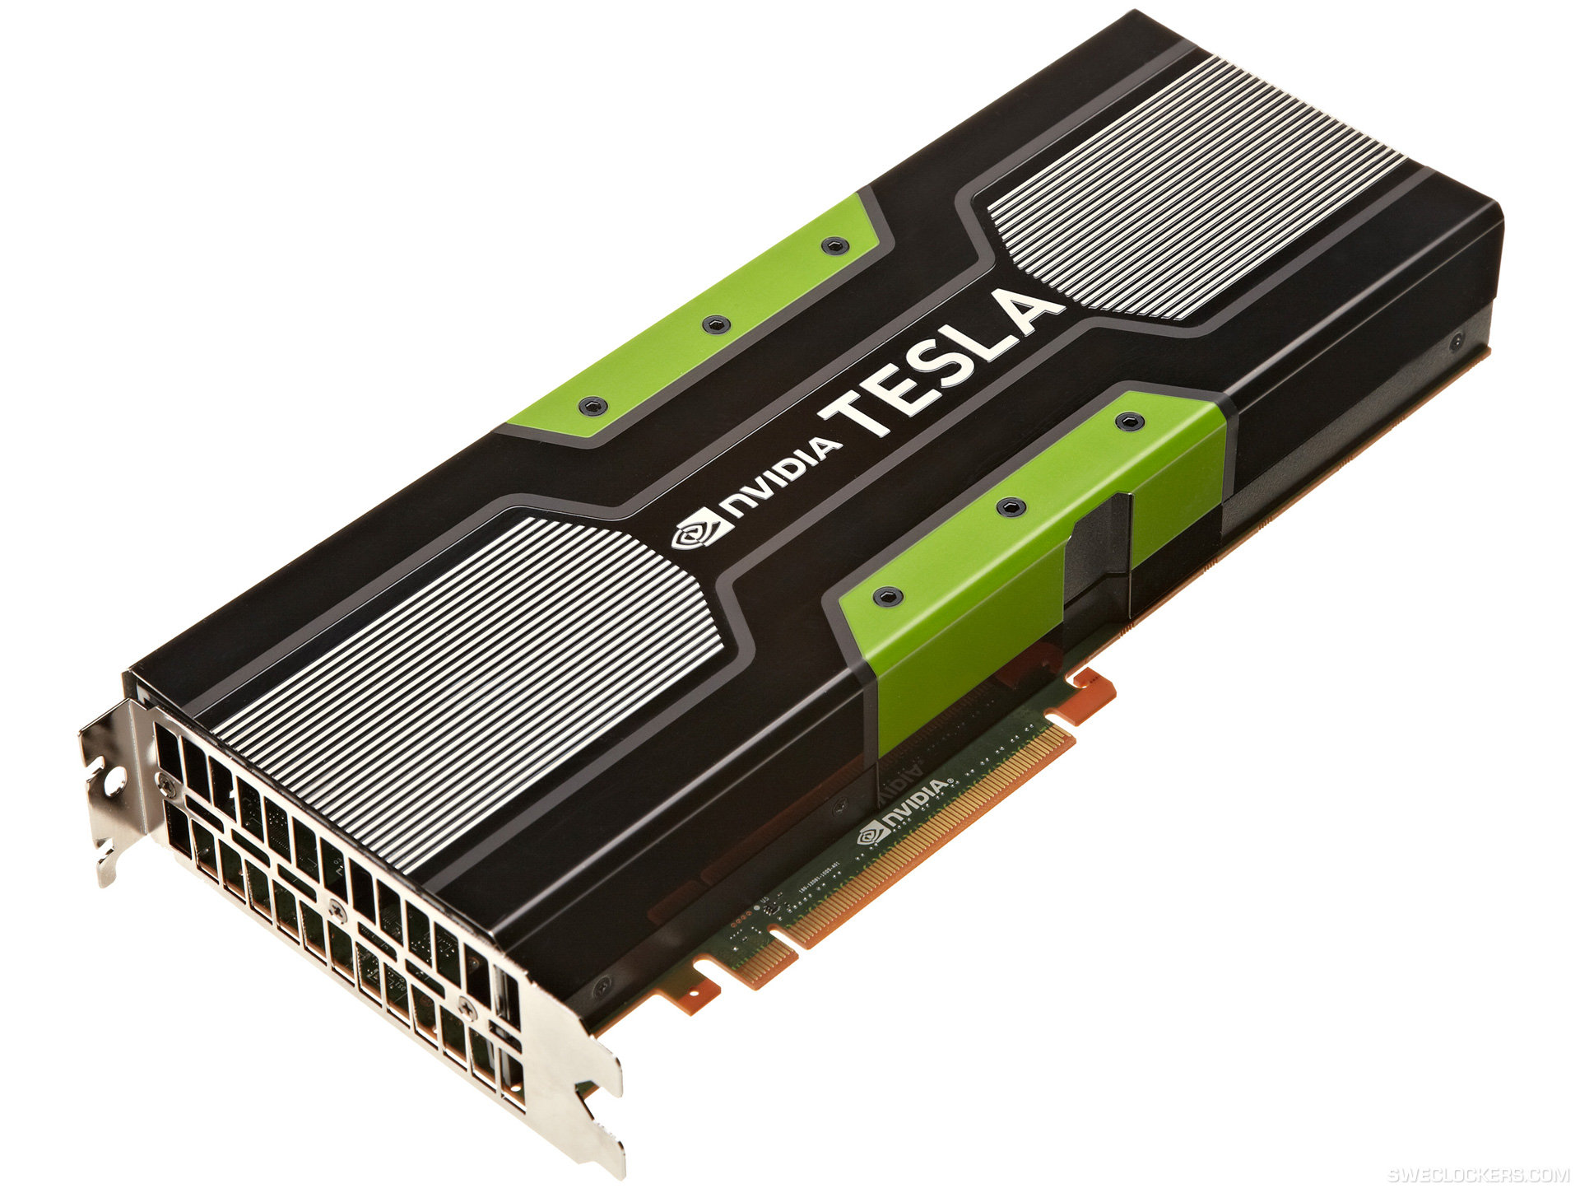
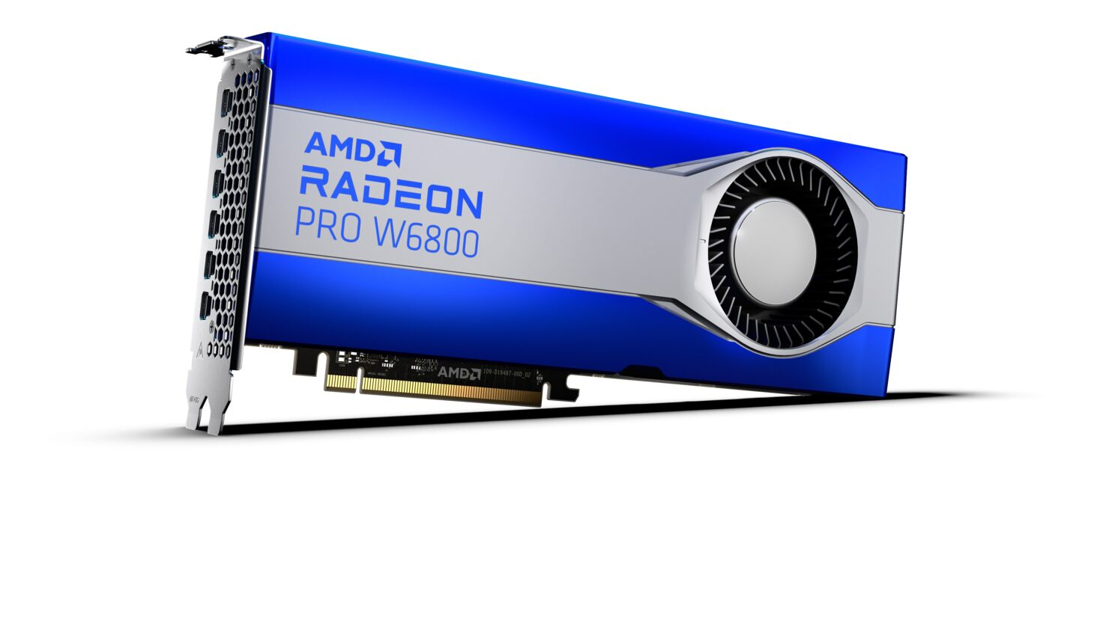
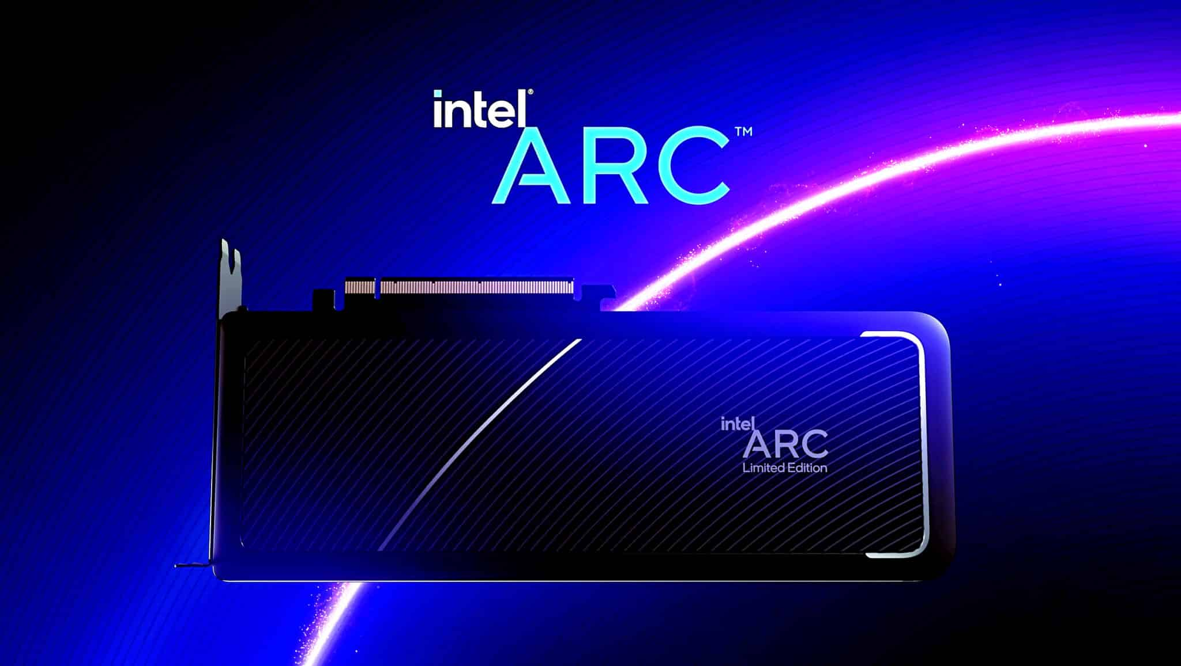

Challenges
GPU
CPU
CUDA
HIP
DPC++
(SYCL)
OpenMP
pthreads
A large code base is difficult to port
Not all features are ported to GPUs
Some features were ported in 3D but not in 2D
Needs deep knowledge of different programming models to port
Maintenance overhead for future architectures

Slide 7
SPECFEM++
Ultimate goal - Provide a single implementation of SPECFEM that works for everyone
SPECFEM2D
SPECFEM3D
SPECFEM3D Globe
SPECFEM++ Library

Slide 8


Key Focus
Modularity
Write dimensionally independent solvers
Easily implement new physics
Easily integrate novel methods
Portability
Compile and run solvers across multiple architectures
High performance across multiple architectures
KOKKOS

Slide 9
Currently Supported Features
Feature | CPU (Serial) | CPU (OpenMP) | CUDA | HIP
2-D Physics (Forward / Misfit Kernels)
Acoustic Isotropic | ✓ / ✓ | ✓ / ✓ | ✓ / ✓ | ✓* / ✓*
Elastic Isotropic SH | ✓ / ✓* | ✓ / ✓* | ✓ / ✓* | ✓* / ✓*
Elastic Isotropic P-SV | ✓ / ✓ | ✓ / ✓ | ✓ / ✓ | ✓* / ✓*
Elastic Anisotropic P-SV | ✓ / ✓ | ✓ / ✓ | ✓ / ✓ | ✓* / ✓*
Elastic Anisotropic SH | ✓ / ✗ | ✓ / ✗ | ✓ / ✗ | ✓* / ✓*
Poroelastic Isotropic (P-SV only) | ✓ / ✗ | ✓ / ✗ | ✓ / ✗ | ✓* / ✗
Elastic Isotropic Cosserat P-SV ** | ✓ / ✗ | ✓ / ✗ | ✓ / ✗ | ✓* / ✗
2-D Medium Coupling
Acoustic-Elastic coupling | ✓ | ✓ | ✓ | ✓
Acoustic-Poroelastic coupling | ✗ | ✗ | ✗ | ✗
Elastic-Poroelastic coupling | ✗ | ✗ | ✗ | ✗
Boundary Conditions (BC)
Absorbing BC (Stacey) | ✓ | ✓ | ✓ | ✓*
Free Surface BC | ✓ | ✓ | ✓ | ✓*
Simulation Setup
Forward Simulations | ✓ | ✓ | ✓ | ✓*
Adjoint Simulations | ✓ | ✓ | ✓ | ✓*
continued
Feature | CPU (Serial) | CPU (OpenMP) | CUDA | HIP
Time Schemes
Newmark | ✓ | ✓ | ✓ | ✓*
Seismograms
Displacement | ✓ | ✓ | ✓ | ✓*
Velocity | ✓ | ✓ | ✓ | ✓*
Acceleration | ✓ | ✓ | ✓ | ✓*
Pressure | ✓ | ✓ | ✓ | ✓*
Curl | ✓ | ✓ | ✓ | ✓*
Rotation | ✓ | ✓ | ✓ | ✓*
Intrinsic Rotation | ✓ | ✓ | ✓ | ✓*
Seismogram Formats
ASCII | ✓ | ✓ | ✓ | ✓*
* Not tested. This, in general means that the feature is not tested in continuous integration if the entire column has a star, and if the row has a star, it means that the feature is not tested/does not match the Fortran version of specfem2d. For the former case, see HIP column, and for the latter case, see the Elastic Isotropic SH row.
** Not peer reviewed yet.

Slide 10
Goals for this workshop
Basic introduction to the code (Hands-on)
You are able to the both install on your desired machine (CPU, CUDA, HIP)
You are able to run a simple example
Run an advanced cookbook & create your own (Hands-on)
Fluid-Solid interface with bathymetry
Kernel computation (Tromp et al. 2005)
Translate an existing specfem2d example to specfem++ - Anisotropic Crystal
More on Kokkos
More on code structure & how to implement new media/boundary conditions

